Slide 1
Unit 3:
Role of the IAEA on preparedness and response for a nuclear or radiological emergency
Name of Lecturer
Organization
Email address
Notes:
Instructions for the Lecturer:
Unit 3 – on role of the IAEA for preparedness and response for a nuclear or radiological emergency, with focus on IAEA role and IAEA safety standards on emergency preparedness and response
Time allocated – 75 minutes, number of ‘active’ slides: 43 of 51
Last slide: 15 minutes discussions, including general discussions on Module XVI on emergency preparedness and response

Slide 2
Learning objective
To understand the roles and responsibilities of the IAEA in preparedness and response for a nuclear or radiological emergency
To become familiar with the IAEA safety standards and other publications on emergency preparedness and response

Slide 3
Contents
Role of IAEA in preparedness
Role of IAEA in response
IAEA’s Incident and Emergency Centre
IAEA safety standards and other publications on emergency preparedness and response

Slide 4
Introduction
Emergency preparedness and response (EPR) activities and capabilities have existed within the IAEA since 1959, shortly after the Agency was created
Continuously and gradually enhanced after the accident at the Chernobyl Nuclear Power Plant in 1986
In 2005, the Incident and Emergency Centre has been established, as focal point for the IAEA’s activities on EPR

Slide 5
Introduction – cont’d
Role of IAEA in EPR, in accordance with:
  IAEA Statute
  Early Notification Convention
  Assistance Convention
Supplemented by a number of mechanisms and arrangements established by Secretariat and IAEA’s policy making organs
Together, these instruments establish IAEA EPR framework for nuclear and radiological emergencies

Slide 6
1. Role of IAEA in preparedness

Slide 7
Roles in preparedness
IAEA mechanisms for capacity building in EPR
Training and exercises
Emergency Preparedness Review (EPREV)
Preparing for International Assistance
IAEA’s in-house preparedness

Slide 8
IAEA mechanisms for capacity building in EPR
Developing international safety standards and guidelines in close cooperation with Member States
Developing tools and operational arrangements, such as EPRIMS and IAEA Reactor Assessment Tool
Developing training materials in EPR and sharing with Member States
Conducting training courses, workshops and exercises at national and international level
Providing on-line networks for knowledge sharing (EPNet)
Providing peer-review services (EPREV)

Slide 9
Convention Exercises (ConvEx)
Member States participate in Convention Exercises – ConvEx
ConvEx-1 | To test availability of National Warning Points and emergency communication links
ConvEx-2 | To test whether responses of Competent Authorities to notification are adequate To drill appropriate use of procedures
ConvEx-3 | To test emergency response arrangements in a severe radiation emergency (regardless of its origin)

Slide 10
Exercising
Exercising response functions in internal exercises
  IEC conducts between 3 and 5 internal IAEA-only full response exercises per year
Exercising with Contact Points
  ConvEx exercises
Decision makers should actively play their role in exercises

Slide 11
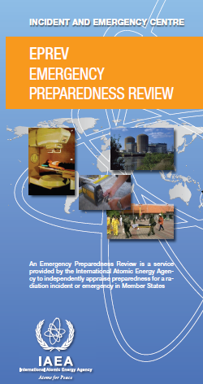
Emergency Preparedness Review (EPREV)
Independently review national arrangements in EPR upon request
Service available since 1999
Statistic:
38 EPREV missions conducted as of May 2015

Slide 12
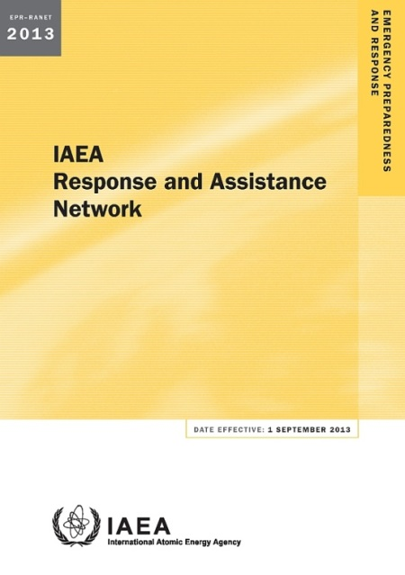
International Assistance (RANET)
Maintaining network of Member States able and willing to assist in case of nuclear or radiological emergency
28 Member States registered in RANET (May 2015)

Slide 13
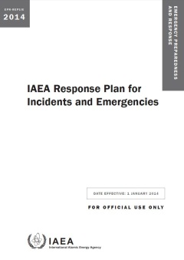
IAEA’s in-house preparedness
IAEA’s Incident and Emergency System
  IAEA Response Plan for Incidents and Emergencies – REPLIE
IEC as IAEA’s focal point
  Develops and keeps response
  arrangements up-to-date
  Maintains and enhances state of the art
  response infrastructure and capabilities
  Develops and implements effective
  training and exercise programme

Slide 14

IAEA’s in-house preparedness (cont’d)
Over 160 trained and qualified IAEA staff serve as emergency responders
New IAEA responders must complete between 8 and 13 hours of in-house training
Each month is dedicated to at least one focus area, and may have between 4 and 12 training classes per month

Slide 15
2. Role of IAEA in response

Slide 16
Roles in response
Notification and official information exchange
Assessment of potential emergency consequences and prognosis of possible emergency progression
Provision of public information
Provision of assistance on request
Coordination of inter-agency response
Notes:
While the responsibility for the emergency response and public protection remains at the national or regional level, the IAEA Secretariat and its staff will respond according to its role and operational arrangements.
The IAEA’s emergency preparedness and response system is based on the IAEA’s emergency plan, that defines the objectives of the IAEA emergency response, the IAEA’s organizational structure in case of a response, the concept of operations for emergency response and also the responsibilities for maintaining the emergency preparedness system of the IAEA.

Slide 17
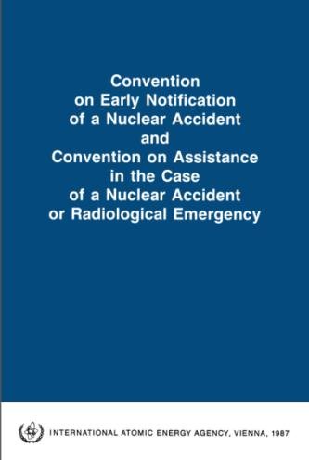
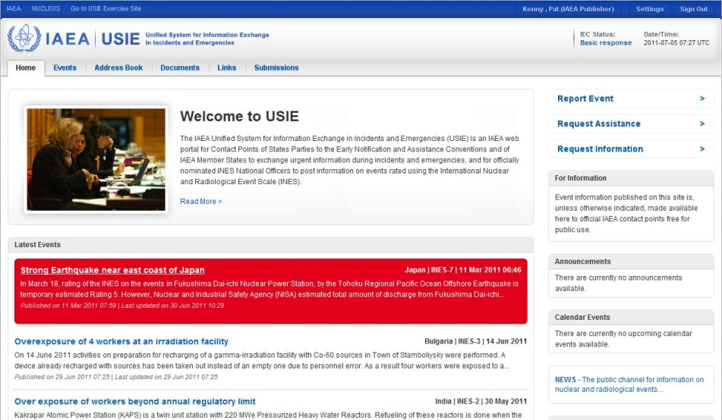
Response – 1
Notification and official information exchange
  through officially designated Contact Points

Slide 18
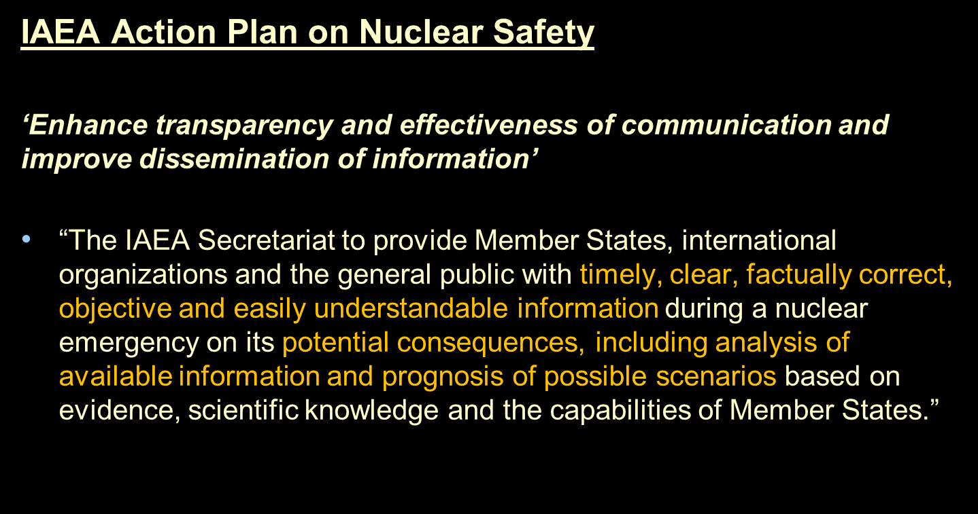
Response – 2
Assessment of potential emergency consequences and prognosis of possible emergency progression

Slide 19
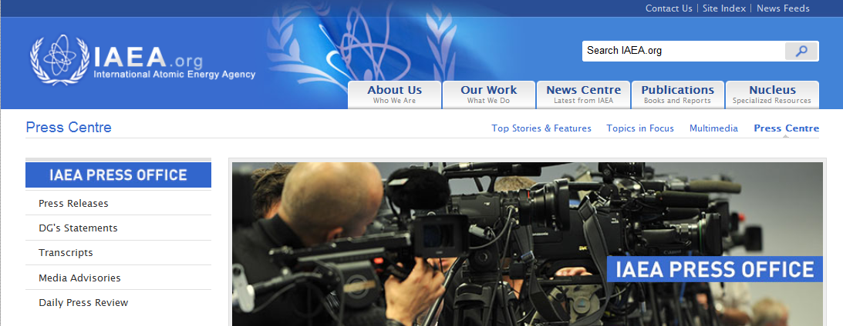
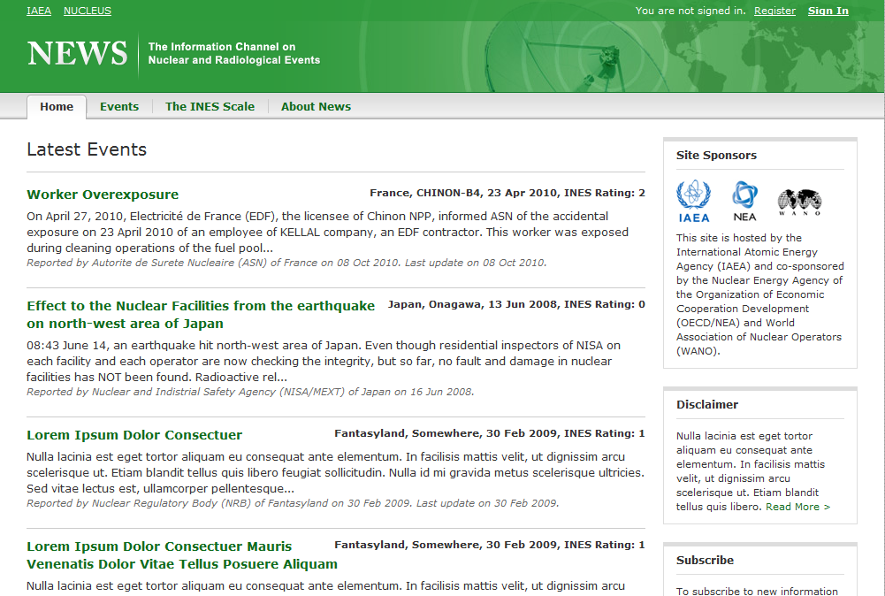
Response – 3
Provision of public information
  Timely, clear, correct and easily understandable

Slide 20
Response – 4
Provision of assistance on request – provide/facilitate and coordinate
  Offers its good offices
  Receives request for assistance
  Performs initial assessment: fact finding mission if necessary
  Transmits request to States and/or international organizations (RANET process used)

Slide 21
Response – 5
Coordination of inter-agency response
  Common understanding of possible impacts and consequences
  Harmonizing international response to nuclear or radiological emergencies to achieve synergy, and speak with ‘one voice’ to media/public

Slide 22
3. IAEA’s Incident and Emergency Centre

Slide 23
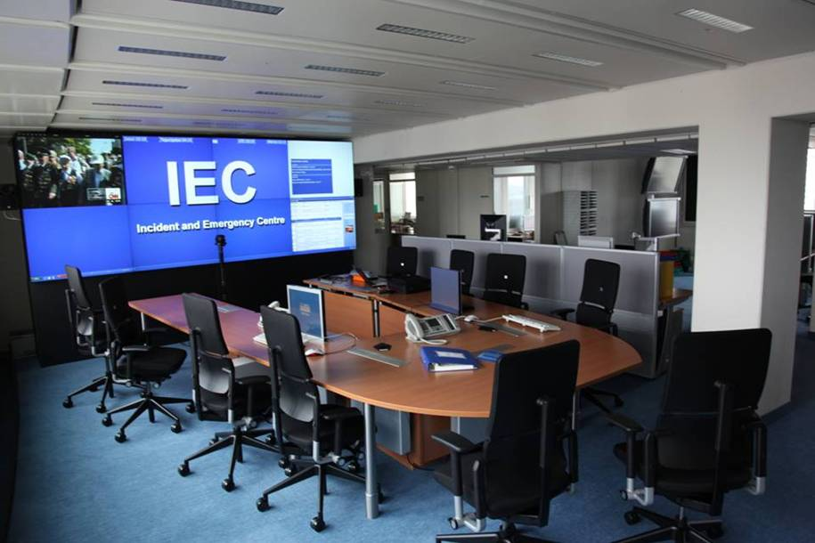
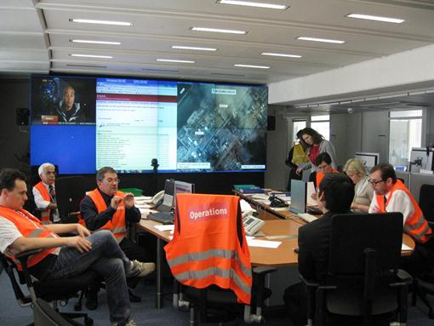
Incident and Emergency Centre (IEC)
Implementing IAEA functions in EPR
Images courtesy IAEA
Focal point for EPR and custodian of IAEA’s IES
Images courtesy IAEA

Slide 24
IEC modes of operation
Normal/Ready Mode
  IEC day-to-day activities
Basic Response Mode
  Responses that do not require 24/7 staffing
Full Response Mode
  Responses that require 24/7 staffing
Image courtesy IAEA

Slide 25
IEC Normal/Ready Mode
Focal point for incoming messages
Staffed during working hours
On-call officers initiate response and activate IEC
  if needed
UN Security Control Centre serves as 24-hour warning point
Notes:
For the Lecturer: the on-call group is part of the on-duty group. At any time, the on-call group consists of 7 experts who are in charge to carry mobile emergency phones so that they can be reached 24/7. The seven positions of the on-call group are: i) emergency response manager (ERM); ii) logistic support officer; iii) radiation safety officer; iv) nuclear safety officer; v) nuclear security officer; vi) public information officer; and vii) external events officer.
The on-call officers are the first ones to be notified (starting with the ERM) and activated in case of an incident/emergency. Ten to twelve experts are qualified and continuously trained for each of these positions, so that they can carry on the on-call service and initiate the response, by rotation, 24/7. In total, about 80 – 90 experts compose the on-call group.
In addition to these, there are experts within the IAEA who are on-duty officers: they are qualified and continuously trained for the different positions during the response to an emergency, but they do not carry mobile emergency phones. They are always activated in a full response mode, and few of them may be activated, depending on the specific of the event, in the basic response mode.

Slide 26
IEC Basic Response Mode
Focal point for a response
  ERM is in charge
Incident and Emergency System (IES) members are activated for response tasks
  on-duty officers
Assistance missions
  may be deployed on MS request
IEC not staffed 24/7 – warning point
  on-call officers continue to be available

Slide 27
IEC Full Response Mode
Action and coordination focal point for entire operational response
IEC is staffed 24/7
On-duty officers perform response tasks
  according to allocated functions and their training (in shifts)
Fact finding mission may be deployed
Warning point and on-call officers are not in function

Slide 28
4. IAEA’s safety standards and other publications on emergency preparedness and response

Slide 29
IAEA safety standards
A key element of a stable and sustainable global safety regime
An international consensus on what constitutes a high level of safety for protecting people and the environment from harmful effects of ionizing radiation
Notes:
The IAEA safety standards provide a system of Safety Fundamentals, Safety Requirements and Safety Guides for ensuring safety. They reflect an international consensus on what constitutes a high level of safety for protecting people and the environment from harmful effects of ionizing radiation.
IAEA safety standards are applied by regulatory bodies and operators around the world to enhance safety in nuclear power generation and in nuclear applications in medicine, industry, agriculture and research and provide consistent and reliable means of ensuring the effective fulfillment of obligations under the international conventions.
The Lecturer should highlight the fact that a special presentation on IAEA safety standards for emergency preparedness and response is going to be delivered to the participants.

Slide 30
IAEA Safety Standards statute
Safety standards are:
  Non binding on Member States but may be adopted by them
  Binding for IAEA’s own activities
  Binding on States in relation to operations assisted by the IAEA or States wishing to enter into project agreements with IAEA

Slide 31
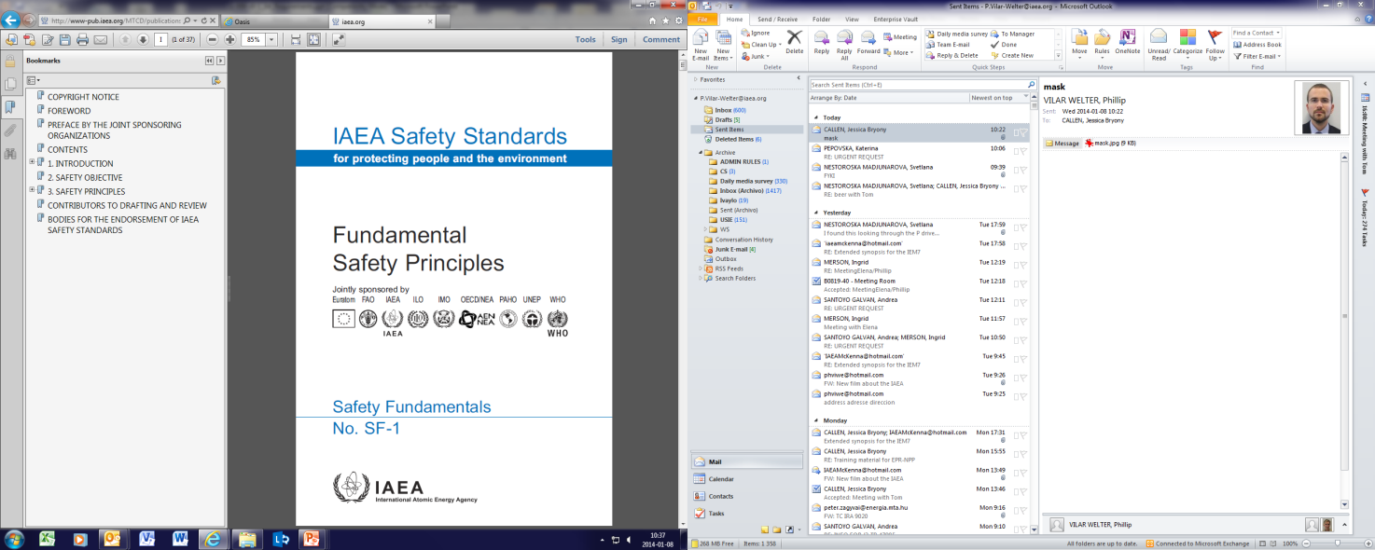
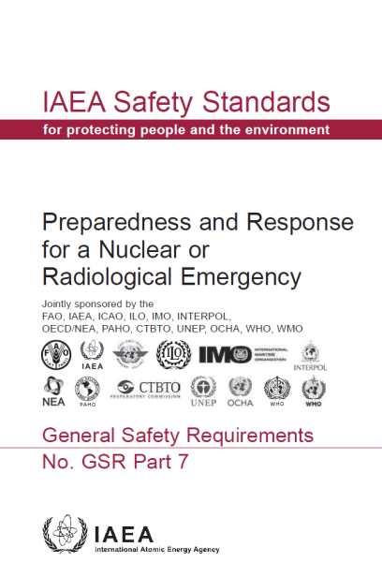
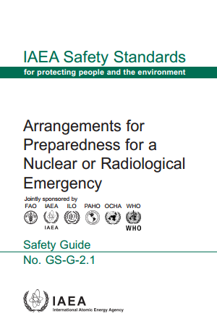
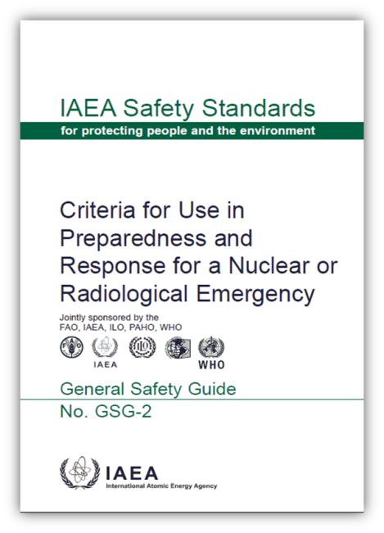
IAEA safety standards on EPR
Safety Fundamentals: Fundamental safety objective and principles for protecting people and environment
Safety Requirements: Requirements that must be met to ensure protection of people and environment
Safety Guides: Recommended ways of meeting the requirements
Notes:
As the primary publication in the IAEA Safety Standards Series, Fundamental Safety Principles establishes the fundamental safety objective and principles of protection and safety. The Fundamental Safety Principles are drafted in language that is understandable to the non-specialist reader. They convey the basis and rationale for the safety standards for those persons at senior levels in government and regulatory bodies.
Safety Requirements publications establish the requirements that must be met to ensure the protection of people and the environment, both now and in the future. The requirements are governed by the objective and principles of the Safety Fundamentals. The format and style of the requirements facilitate their use by Member States for the establishment, in a harmonized manner, of their national regulatory framework.
Safety Guides provide recommendations and guidance on how to comply with the safety requirements, indicating an international consensus on the measures recommended. The Safety Guides present international good practices, and increasingly they reflect best practices, to help users striving to achieve high levels of safety.

Slide 32
Safety Fundamentals: Principle 9
  “Arrangements must be made for emergency preparedness and response for nuclear or radiation incidents.”
Notes:
Establishes the fundamental safety objective, safety principles and concepts that provide the bases for the IAEA’s safety standards and its safety related programme
Published in 2006
Co-sponsored by Euratom, FAO, IAEA, ILO, IMO, OECD/NEA, PAHO, UNEP and WHO

Slide 33
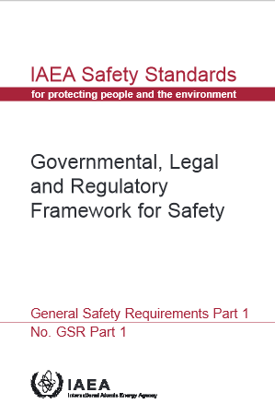
General Safety Requirements Part 1
No. GSR Part 1
Includes requirements for establishing a governmental, legal and regulatory framework for safety, as part of the nuclear safety infrastructure
Requirement no. 8 “Emergency Preparedness and Response”:
  “The GOVERNMENT SHALL make provision for emergency preparedness to enable a timely and effective response in a nuclear or radiological emergency”
Notes:
GSR Part 1
Requirements for the Government (Req. 8):
To make each authorized party responsible for preparing an emergency response plan and for making arrangements for EPR
To establish a nationwide system, including EPR arrangements to protect the public in a radiation emergency
To designate competent authorities with responsibilities and allocated resources to establish EPR arrangements for coping with consequences of a radiation emergency
To assign clear responsibilities for decision making in an emergency
Regulatory Body to be prepared for a timely emergency response
Regulatory Body shall advise Government and competent authorities and shall provide expert services (e.g. services for radiation monitoring and risk assessment for actual and expected future radiation risks) in accordance with the responsibilities assigned to it

Slide 34
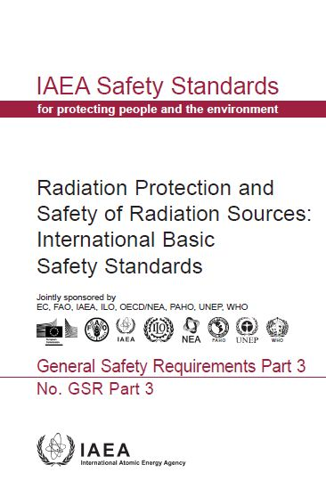
General Safety Requirements Part 3
No. GSR Part 3
Relevant requirements in Section 4 on emergency exposure situations
  Published 2014
  Co-sponsored by EC, FAO, IAEA, ILO, OECD\NEA, PAHO, UNEP, WHO
  Requirements level: ‘Shall’
  All addressed to the Government
Notes:
GSR Part 3 – Chapter 4:
Generic Requirements
Requirement 43: Emergency management system
“The GOVERNMENT SHALL ensure that an integrated and coordinated emergency management system is established and maintained.”
Public Exposure
Requirement 44: Preparedness and response to an emergency
“The GOVERNMENT SHALL ensure that protection strategies are developed, justified and optimized at the planning stage, and that emergency response is undertaken through their timely implementation.
Exposure of Emergency Workers
Requirement 45: Arrangements for controlling the exposure of emergency workers
“The GOVERNMENT SHALL establish a programme for managing, controlling and recording the doses received in an emergency by emergency workers.”
Transition from an Emergency Exposure Situation to an Existing Exposure Situation
Requirement 46: Arrangements for the transition from an emergency exposure situation to an existing exposure situation
“The GOVERNMENT SHALL ensure that arrangements are in place and are implemented as appropriate for the transition from an emergency exposure situation to an existing exposure situation.”

Slide 35
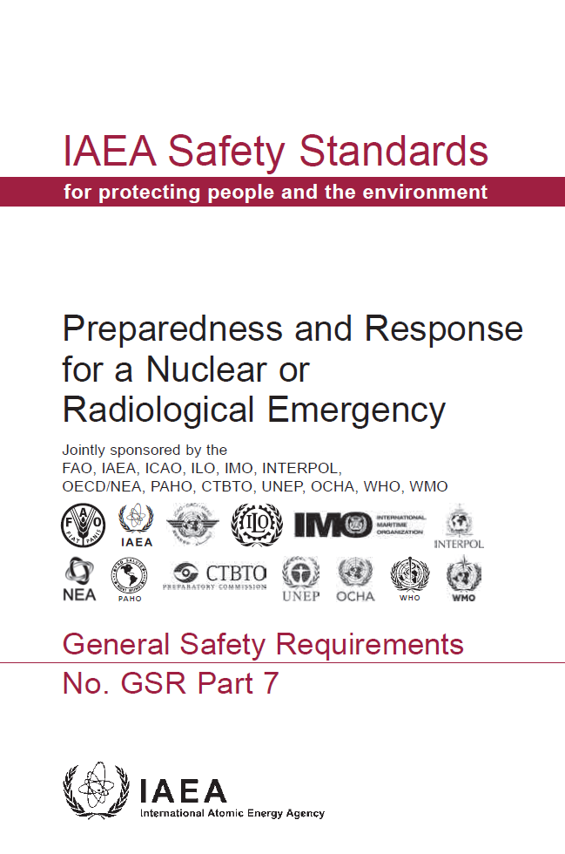
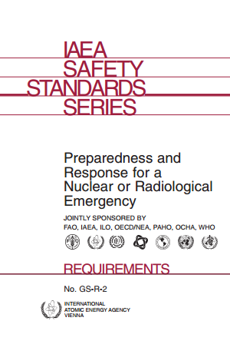
General Safety Requirements Part 7
No. GSR Part 7 (published 2015)
Establishes requirements for an adequate level of preparedness and response for a nuclear or radiological emergency, irrespective of its cause
Requirements level: ‘Shall’
Co-sponsored by FAO, IAEA, ICAO, ILO, IMO, Interpol, OECD/NEA, PAHO, UNEP, UNOCHA, WHO, WMO, CTBTO
Supersedes No. GS-R-2 issued in 2002
Notes:
This is the main IAEA Safety Standard with requirements on emergency preparedness and response.

Slide 36
Requirements in GSR Part 7
In total: 26 overarching requirements
    General: 5
    Functional: 14
    Infrastructural: 7
For meeting the goals of emergency preparedness and response

Slide 37
GSR Part 7 - General requirements:
To be fulfilled before any emergency planning can start
    Emergency management system
    Roles and responsibilities
    Assessment of hazards
    Protection strategy

Slide 38
GSR Part 7 - Functional requirements:
Functions to be performed for response to be effective and goals of emergency response to be met
  Managing emergency response operations
  Identifying, notifying and activating
  Taking mitigatory actions
  Taking urgent protective and other response actions
  Providing instructions, warning and relevant information to the public
Notes:
The lecturer to mention that for each response function, GSR Part 7 includes requirements for all response organizations, including operators.
In addition to GSR Part 7, a good material for understanding the practical aspects of implementation are included in the ERP-METHOD 2003 publication.
In this presentation, only few important elements related to functional requirements are highlighted, for the sake of better understanding of essential issues.

Slide 39
GSR Part 7 - Functional requirements (cont’d):
Protecting emergency workers and helpers
Managing the medical response
Communic ating with the public
Taking early protective and other actions
Managing radioactive waste
Mitigating the non-radiological consequences
Requesting, providing and receiving int. assistance
Terminating an emergency
Analysis of emergency and the response
Notes:
The lecturer to mention that for each response function, GSR Part 7 includes requirements for all response organizations, including operators.
In addition to GSR Part 7, a good material for understanding the practical aspects of implementation are included in the ERP-METHOD 2003 publication.

Slide 40
GSR Part 7 – Requirements for Infrastructure:
Infrastructural elements essential for performing response functions
Authority
Organization and staffing
Coordination
Plans and procedures
Logistical support and facilities
Training, drills and exercises
QM programme
Notes:
The lecturer to mention that for each response function, GSR Part 7 includes requirements for all response organizations, including operators.
In addition to GSR Part 7, a good material for understanding the practical aspects of implementation are included in the ERP-METHOD 2003 publication.
More about infrastructural elements will be presented in a next presentation.

Slide 41
Safety Guides
No. GS-G-2.1
Provides recommendations on implementation of specific safety requirements on emergency preparedness and response
  Recommendations level: ‘Should’
  Published in 2007
  Co-sponsored by FAO, IAEA, ILO, OCHA, WHO, PAHO

Slide 42
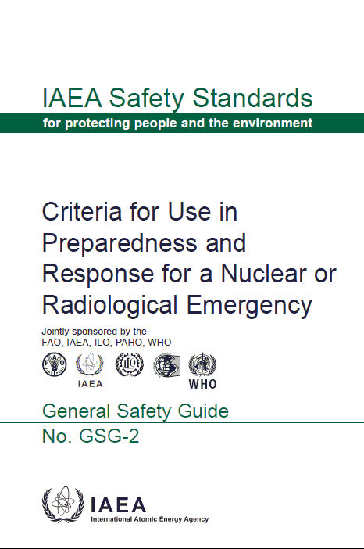
Safety Guides
No. GSG-2
  Provides guidance on criteria for taking protective actions and other response actions in a nuclear or radiological emergency
  Recommendations level: ‘Should’
  Published in 2011
  Co-sponsored by FAO, IAEA, WHO,
  PAHO, ILO
  Supersede intervention levels and generic action levels contained in GS-R-2

Slide 43
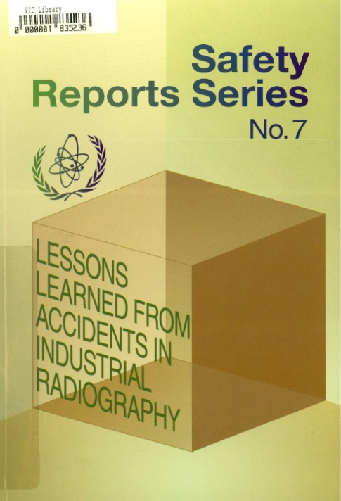
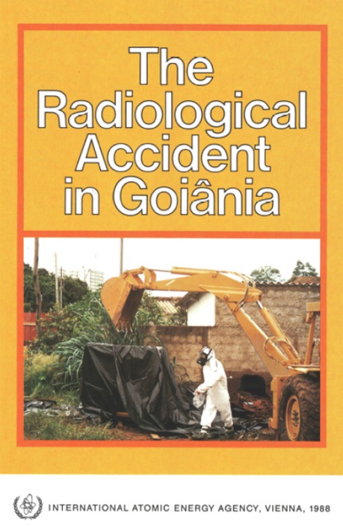
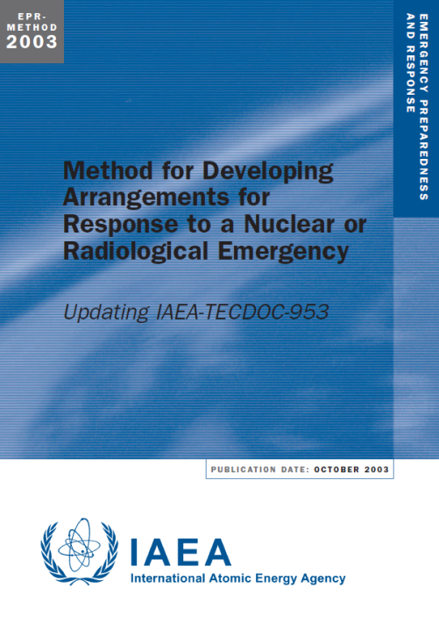
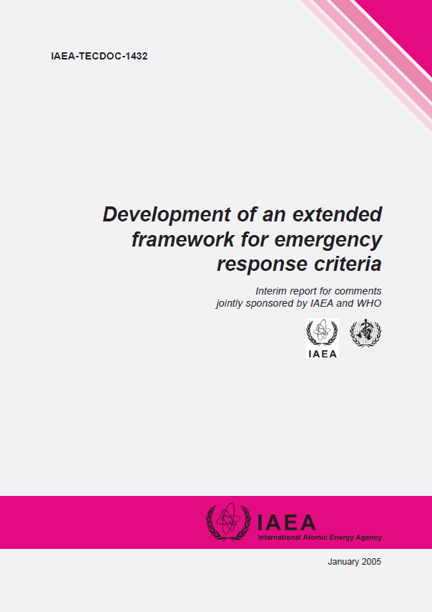
What is not a Safety Standard
Other Agency’s publications than Safety Fundamentals, Safety Requirements and Safety Guides, for example:
  Safety Reports
  Accident Reports
  Emergency Preparedness and Response (EPR) Series
  TECDOC Series, etc.

Slide 44

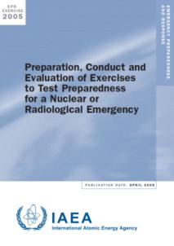
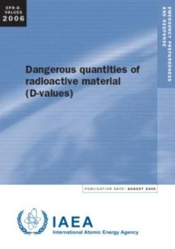
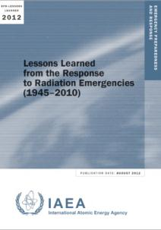
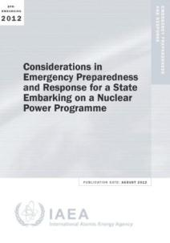
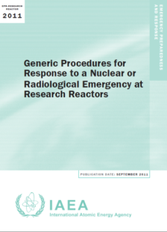
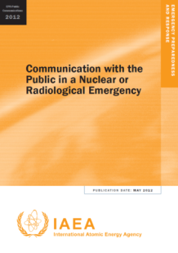
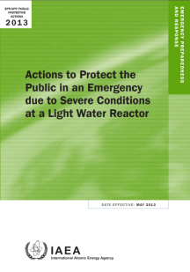
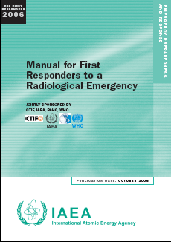
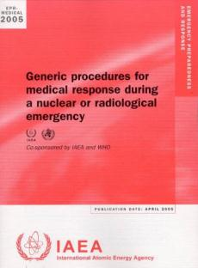
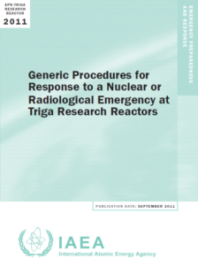
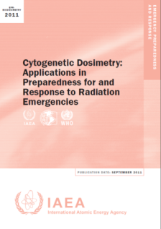
Examples of EPR Series
Notes:
There is a specific series for IAEA publications in the area of emergency preparedness and response - the EPR series. All these publications are informational in nature. They may describe good practices in details and give practical examples and detailed methods that can be used to meet safety standards. They do not establish requirements or make recommendations. They are not part of IAEA Safety Standards.
Associated with the practical manuals the IAEA has developed standardised training material that is used for supporting all its technical co-operation work and extra-budgetary programmes.
IAEA Accident Reports:
The Radiological Accident in Goiânia (1988)
The Radiological Accident in San Salvador (1990)
The Radiological Accident in Soreq (1993)
The Radiological Accident at the Irradiation Facility in Nesvizh (1996)
An Electron Accelerator Accident in Hanoi, Viet Nam (1996)
Accidental Overexposure of Radiotherapy Patients in San Jose, Costa Rica (1998)
The Radiological Accident in the Reprocessing Plant at Tomsk (1998)
The Radiological Accident in Tammiku (1998)
The Radiological Accident in Istanbul (2000)
The Radiological Accident in Yanango (2000)
The Radiological Accident in Lilo (2000)
The Criticality Accident in Sarov (2001)
The Radiological Accident in Gilan (2002)
The Radiological Accident in Samut Pakarn (2002)
The Radiological Accident in Cochabamba (2004)
Accidental Overexposure of Radiotherapy Patients in Bialystok (2004)
The Radiological Accident in Nueva Aldea (2009)
The Radiological Accident in Lia, Georgia (2014)

Slide 45
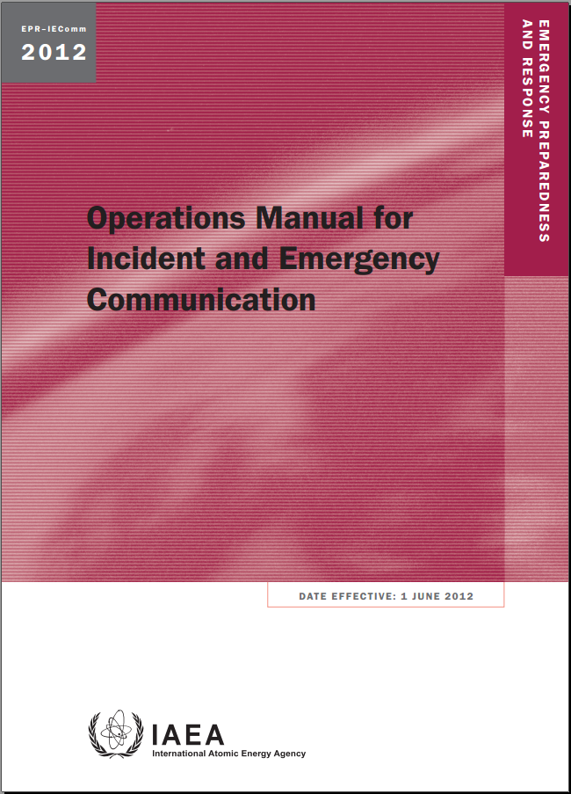
Operational arrangements
Member States
IEComm
The manual for
  Communication protocols
  for Contact Points
  under the Emergency Conventions
  INES National Officers
Notes:
More about these operational arrangements will be presented in another presentation, dealing with the IAEA role for emergency preparedness and response.

Slide 46
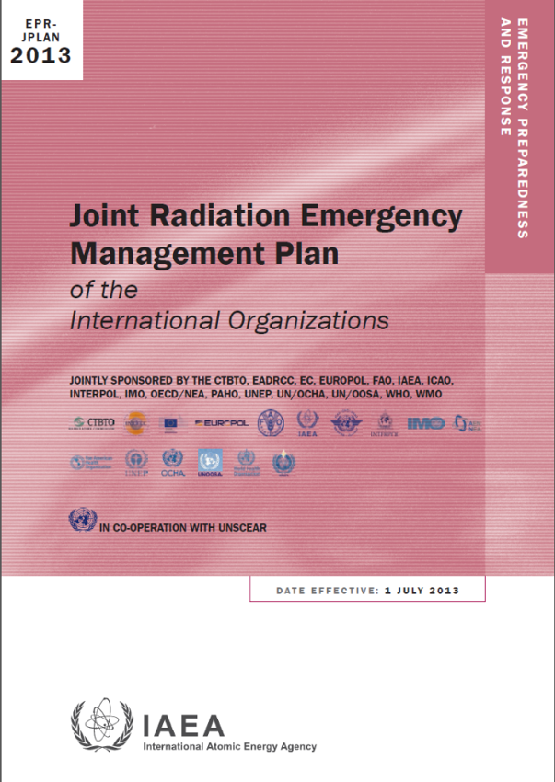
Operational arrangements
International Organizations
JPLAN
  The plan of International Organizations
Describes
  Arrangements for responding
  Measures for developing and maintaining the arrangements
Notes:
The IAEA is the main coordinating body for the development and maintenance of the Joint Plan. The Joint Plan does not prescribe arrangements between the participating organizations, but describes a common understanding of how each organization acts during a response and in making preparedness arrangements.
The International Atomic Energy Agency (IAEA) has specific functions assigned to it under these Conventions, to which the the European Commission, through the European Atomic Energy Community (Euratom), the Food and Agriculture Organization of the United Nations (FAO), the World Health Organization (WHO) and the World Meteorological Organization (WMO) are full Parties. The arrangements between the IAEA, States and international intergovernmental organizations (‘international organizations’) for facilitating the practical implementation of those articles of the two Conventions that are operational in nature are documented in the IAEA’s Operations Manual for Incident and Emergency Communication (IEComm)2 . In addition to the IEComm arrangements and pursuant to the obligations placed on the IAEA by the Conventions, the IAEA regularly convenes the Inter-Agency Committee on Radiological and Nuclear Emergencies (IACRNE)3 , whose purpose is to coordinate the arrangements of the relevant international organizations for preparing for and responding to radiation incidents or emergencies.

Slide 47
Summary
The IAEA’s role in emergency preparedness and response is undertaken in accordance with:
  Convention on Early Notification of a Nuclear Accident and the Convention on Assistance in the Case of a Nuclear Accident or Radiological Emergency,
  the Agency's Statute,
  the IAEA safety standards,
  relevant decisions of the policy-making organs, inter-agency agreements, and best international practice
In order to perform its functions, the IAEA developed and maintain international safety standards and operational arrangements for EPR

Slide 48
Key Points
The IAEA helps Members States for capacity building, developing EPR framework and in response to nuclear or radiological emergency
In times of emergencies the IAEA is providing
  Notification and information exchange
  Assessment and prognosis of potential consequences
  Public information
  Assistance on request
  Coordination of inter-agency response
IAEA’s Incident and Emergency Centre is the hub of all these operations

Slide 49
List of abbreviations
EPR – emergency preparedness and response
IEC – Incident and Emergency Centre
IES – Incident and Emergency System
ERM – Emergency Response Manager
IAEA – International Atomic Energy Agency
RANET – Response Assistance NETwork
MS – Member State

Slide 50
References
IAEA SF-1 (2006)
IAEA GSR Part 7
IAEA GSG-2 (2011)
IAEA GS-G-2.1 (2007)
EPR-Series Publications
Accident Reports

Slide 51
Thank you!
Notes:
Thank you!

Slide 52

Discussions on Unit 3 +
General discussions on Module XVI
[15 minutes]
Notes:
Thank you!

